Slide 1

Advanced Topics in Economic Evaluation and Healthcare
Lecture #10: Funding Prioritization, League Tables and the role of HTA organizations.

Slide 2
Lecture Overview
In this lecture we will provide an overview on how funding decisions are made. In particular we will discuss:
  The Payer’s Problem.
  Making Funding Decisions with The Cost Effectiveness League Table.
  Problems with League Table Decision Making.
  Regulatory Issues and the Role of HTA Organizations.
By the end of this lecture you will have an appreciation for some the tools used in funding decisions and the broader HTA landscape.

Slide 3
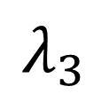
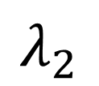
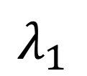
The Payer’s Problem
Analysts conduct cost effectiveness analysis of drugs that
have passed clinical trials.
$$λ_{1}$$
$$λ_{2}$$
$$λ_{3}$$

Slide 4
The Payer’s Problem
These ICERs are submitted in the form of funding proposals to the Ministry of Health.
$$λ_{1}$$
Ministry of
Health
$$λ_{2}$$
$$λ_{3}$$

Slide 5



The Payer’s Problem
The Ministry of Health Must Decide
Which Treatments to Fund and Which
Ones to Reject.
$$λ_{1}$$
Ministry of
Health
$$λ_{1}$$
$$λ_{2}$$
$$λ_{3}$$
$$λ_{2}$$
$$λ_{3}$$
This is done often with the use of
Cost Effectiveness League Tables.

Slide 6
Funding Decisions with the League Table

Slide 7
Funding Decisions with the League Table
To determine which treatments obtain funding and which do not, we consider two circumstances.
  The case where the budget is defined.
  The case when the budget is not defined.
When we have a defined budget, the optimal list of treatments to fund is based on the following rule:
1. Fund the Treatment with the Smallest ICER and subtract the estimated budget impact from the defined budget.
2. At the next smallest ICER look at the budget impact and if the treatment is feasible fund it, otherwise stop.
3. Repeat until the budget is exhausted.

Slide 8
The Cost Effectiveness League Table
The Cost Effectiveness League Table, is list of treatments with their corresponding ICER and other information.
It is a simple way to organize decision making around which treatments to fund and which treatments not to fund.
While there can be lots of information included in a league table the core is just a list of treatments with their ICERs organizes from smallest to largest.
Rank | Intervention | ICER (CAD per QALY)
1 | Drug A | $11,333/QALY
2 | Drug B | $22,000/QALY
3 | Surgical Procedure | $32,500/QALY
4 | Advanced Biologic | $133,333/QALY
5 | Gene Therapy | $197,059/QALY

Slide 9
Funding Decisions with a Fixed Budget.
Rank | Intervention | ICER (CAD per QALY) | Size of Eligible Population | Unit Cost (CAD) | Budget Impact
1 | Drug A | $11,333/QALY | 12,000 patients | $1,200 | 14.4 Million CAD
2 | Drug B | $22,000/QALY | 7,500 patients | $4000 | 30 Million CAD
3 | Surgical Procedure | $32,500/QALY | 3,200 patients | $9000 | 28.8 Million
4 | Advanced Biologic | $133,333/QALY | 1,100 patients | $20,000 | 22 Million
5 | Gene Therapy | $197,059/QALY | 150 patients | $65,000 | 9.75 Million
Question: Suppose we have a Budget of 50 Million Dollars?
Which Treatments do we fund?

Slide 10
Funding Decisions with a Fixed Budget.
Rank | Intervention | ICER (CAD per QALY) | Size of Eligible Population | Unit Cost (CAD) | Budget Impact
1 | Drug A | $11,333/QALY | 12,000 patients | $1,200 | 14.4 Million CAD
2 | Drug B | $22,000/QALY | 7,500 patients | $4000 | 30 Million CAD
3 | Surgical Procedure | $32,500/QALY | 3,200 patients | $9000 | 28.8 Million
4 | Advanced Biologic | $133,333/QALY | 1,100 patients | $20,000 | 22 Million
5 | Gene Therapy | $197,059/QALY | 150 patients | $65,000 | 9.75 Million
Question: Suppose we have a Budget of 50 Million Dollars?
Which Treatments do we fund?
Following our procedure, where we fund Drug A and Drug B.
THE EMPIRICAL WILLINESS TO PAY THRESHOLD IS $22,000/QALY

Slide 11
Funding Decisions Based on Thresholds
Rank | Intervention | ICER (CAD per QALY) | Size of Eligible Population | Unit Cost (CAD) | Budget Impact
1 | Drug A | $11,333/QALY | 12,000 patients | $1,200 | 14.4 Million CAD
2 | Drug B | $22,000/QALY | 7,500 patients | $4000 | 30 Million CAD
3 | Surgical Procedure | $32,500/QALY | 3,200 patients | $9000 | 28.8 Million
4 | Advanced Biologic | $133,333/QALY | 1,100 patients | $20,000 | 22 Million
5 | Gene Therapy | $197,059/QALY | 150 patients | $65,000 | 9.75 Million
If we use a threshold of 50,000 dollars per QALY, we overshoot the budget.

Slide 12
Concerns about League Tables

Slide 13

Problem #1: League tables combine studies with very different perspectives
The League table is focused on the ICER alone.
There is little guidance on how to combine study perspectives in the decision-making process.
While we are free to choose a perspective for individual cost effectiveness analysis (i.e. societal, payer, hospital or patient), it becomes increasingly difficult to say if we can combine studies with different perspectives.
This is even more difficult when we are looking at evidence of cost effectiveness from different countries.

Slide 14
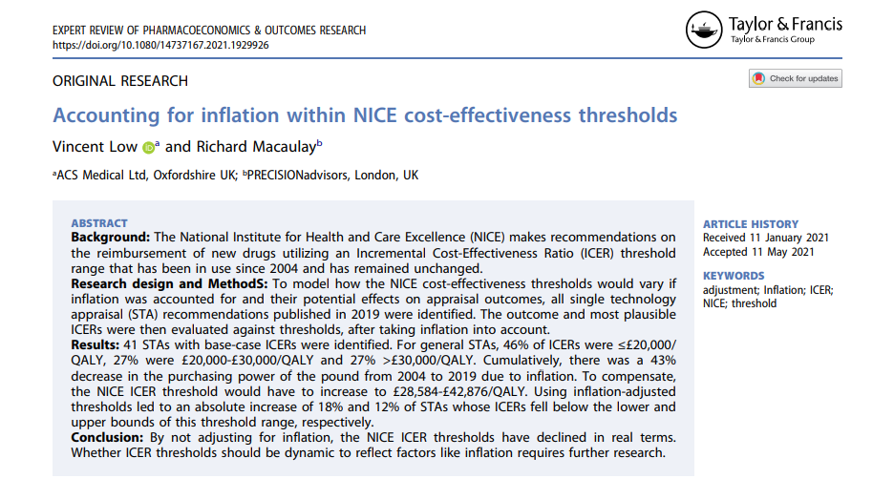
Problem #2: Time and Inflation
Cost-effectiveness analyses are published at different points in time.
Are cost effectiveness analyses from 5 years ago relevant to decision makers now?
  As a representation clinical pathways and realization of costs and benefits- YES.
  For Point Estimates of the ICER?- Questionable.
ICERs are rarely (if not never) adjusted for inflation.
This is because inflation adjustment will always make ICERS lower/ oversell.
Reminiscent of the Keeler-Cretin Paradox.
CEA UNDER
INFLATION IS UNCLEAR!

Slide 15
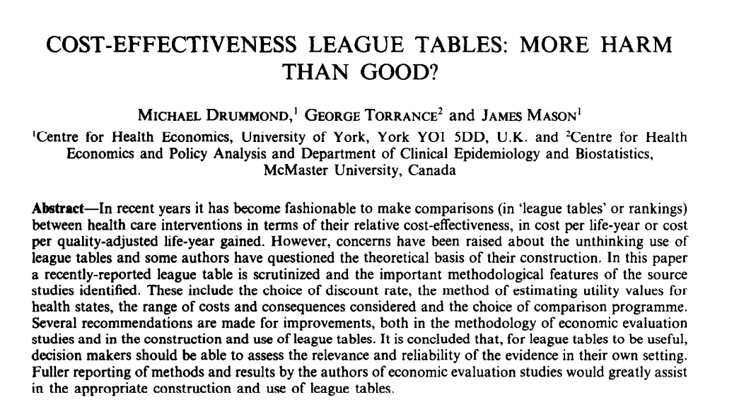
Problem #3: Uncertainty is Discounted
The League table makes the assumption that decision makers are risk neutral with respect to making investments in health.
This means that the probability of cost-effectiveness does not serve a role in ranking treatments against others.
While this could be a way to “refine” the selection of treatments, given that there is no threshold for the CEAC, theres no way to organize this.
While some can come up with a procedure to do this, this is currently not the practice.

Slide 16
Regulatory Problems

Slide 17
The Payer’s Problem
$$λ_{1}$$
Ministry of
Health
$$λ_{1}$$
$$λ_{2}$$
$$λ_{3}$$
$$λ_{2}$$
$$λ_{3}$$

Slide 18

The Payer’s Problem
$$λ≤50,000$$
$$λ_{1}$$
Ministry of
Health
$$λ_{1}$$
$$λ_{2}$$
$$λ_{3}$$
$$λ_{2}$$
$$λ_{3}$$

Slide 19



The Payer’s Problem
$$λ≤50,000$$
$$λ_{1}≤50,000$$
Ministry of
Health
$$λ_{1}$$
$$λ_{2}$$
$$λ_{3}$$
$$λ_{2}≤50,000$$
$$λ_{3}≤50,000$$
If the Ministry Makes Known its Threshold
Explicitly, Every Drug Company will Design
Their Analyses which “Market” Their Drugs
as Meeting that Threshold

Slide 20
Health Technology Assessment Agencies Globally

Slide 21





HTA Agencies Globally
Canadian Drug Authority
(Canada)
National Institute for Health
and Care Excellence
(United Kingdom)
Institute for Clinical
and Economic Review
(United States)
Swedish Agency for Health Technology Assessment and Assessment of Social Services
(Sweeden)
Institute for Quality and Efficiency in Health Care
(Germany)
Haute Autorité de Santé
(France)

Slide 22
What do HTA Agencies Do?
HTA Organizations are typically federally funded organizations which conduct independent clinical review and cost effectiveness analysis of new drugs and health technologies.
They exist because drug companies have an incentive to market their drugs which may overplay their effectiveness.
In general, HTA Organizations do the following tasks:
  They evaluate clinical effectiveness and cost-effectiveness of prescription drugs, providing recommendations to public drug plans on whether they should be publicly funded.
  Publish Clinical and Economic Guidelines for Public Plans to follow.
  Conduct systemic reviews and summarize the literature for best practices which help hospital regulators.
HTA Organizations do NOT determine if a drug is paid for. Instead they only provide advice.
They exist to solve “information” problems.

Slide 23
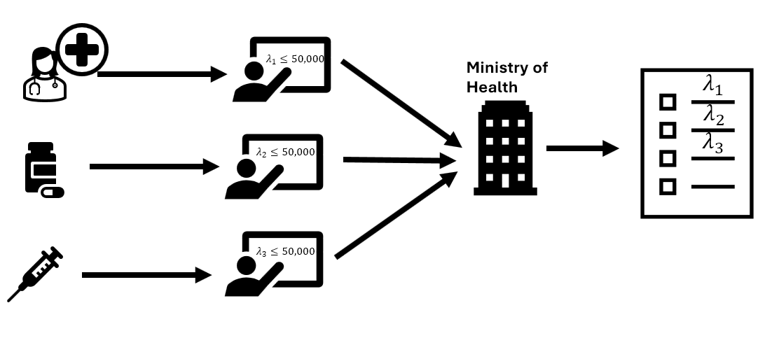
How the CDA Changes the Picture
The CDA offers Independent advice to the Ministry
of health which can save time and resources when making reimbursement decisions

Slide 24
Types of recommendations by the CDA
In general there are four types of recommendations which may be made by the Canadian Drug Authority. These are:
  Reimburse (without conditions): The drug is recommended for public coverage as submitted, with no special clinical or financial restrictions required.
  Reimburse with conditions: The drug is recommended for public coverage only if specific clinical criteria (such as patient population, line of therapy, or prescriber specialty) and/or financial conditions (such as a confidential price reduction) are met.
  Time-limited reimbursement: Public funding is recommended for a temporary, limited period. This is conditional on the manufacturer conducting ongoing clinical studies to resolve existing evidence uncertainties, which will lead to a future reassessment and a final recommendation.
  Do not reimburse: The drug is not recommended for public reimbursement because clinical effectiveness and/or cost-effectiveness have not been adequately demonstrated.

Slide 25
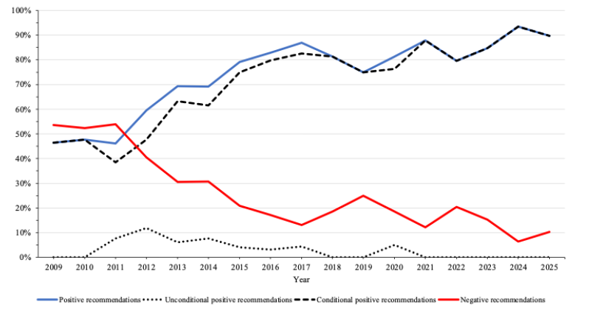
Trends in Reimbursement Recommendations by the CDA
Overwhelmingly, the CDA has
been providing more conditional
positive recommendations than
Negative ones.
Source: Rawson, N. S. (2026). Reimbursement recommendations for new medicines in Canada: current trends in an uncertain era. Canadian Health Policy.

Slide 26
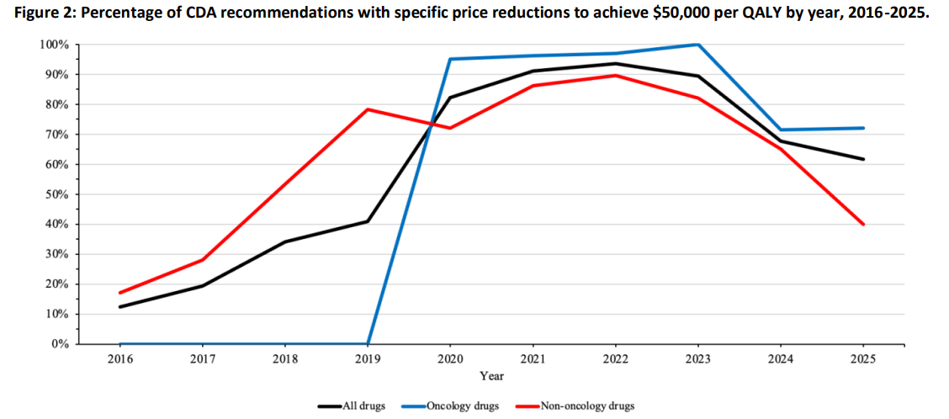
Trends in Reimbursement Recommendations by the CDA
This has been due to the requirement
in part to a request for a reduction in
price.
This kind of bargaining over the price of
drugs has only been since 2019 for
oncology drugs.
Source: Rawson, N. S. (2026). Reimbursement recommendations for new medicines in Canada: current trends in an uncertain era. Canadian Health Policy.

Slide 27
Concluding Remarks
In this lecture we discussed how funding decisions are made. We discussed.
  The Payer’s Problem.
  Making Funding Decisions with The Cost Effectiveness League Table.
  Problems with League Table Decision Making.
  Regulatory Issues and the Role of HTA Organizations.
Understanding the pharmaceutical regulatory environment is crucial bringing drugs to market even if economics is only one part of a reimbursement decision.

